Slide 1


BANGLADESH UNIVERSITY OF BUSINESS & TECHNOLOGY
Course Title: Software Development-1 Supervised By:
Course Code: CSE 100 Badhan Chandra Das
Lecturer Dept. of CSE (BUBT)
AARchive TRIVIA GAME
1

Slide 2
Team AARchive
Md. Abid Ul Islam 20211103060 [LEADER]
Alamgir Khan 20211103053
Kazi Rifat Hossain Ratun 20211103060
Md. Omar Faruk 19202103393
2

Slide 3
TABLE OF CONTENTS
1. What is Trivia game?.................
2. Our Objective………….…………………….
3. Existing System vs Proposed System.
4. Software Design…………….………………
5. Tools & Software Used…………………
6.Modules……..…………….……………
7. User Interface…..……..……..…
8.Conclution & Future Work.......
3

Slide 4
What is trivia game
1
4

Slide 5
TRIVIA GAME
A Trivia game is a general knowledge based quiz game.
It increases learning capability and time complexity.
Provides Knowledge on different & individual topics to play on.
It maximizes your competitive mentality as you compete with your friends.
5

Slide 6
Our objectives
2
6

Slide 7
OUR OBJECTIVES
Promote group harmony (either within school, organization or just a group of people.
Want to make peoples leisure time enjoyable and full of learning.
Leading to greater creativity, innovation & problem-solving skills.
Increase competitiveness, mental health & cognitive skills.
7

Slide 8
Existing system vs Proposed system
3
8

Slide 9
EXISTING SYSTEM VS PROSPOSED SYSTEM
AARchive Trivia Game
Proposed System
Existing System
Multiple User system.
Different categories to play.
Leaderboard to have a competitive feeling.
Exit from anywhere & no repetitive questions.
Sound System.
Completed
Completed
Completed
Completed
Completed
9

Slide 10
Software Design:
4
10

Slide 11
SOFTWARE DESIGN
MAIN MENU
LOGIN
REGISTER
LEADERBOARD
QUIT GAME
11

Slide 12
LOGIN
CATEGORY
QUESTIONS ON SCIENCE
QUESTIONS ON HISTORY
QUESTIONS ON SPORTS AND IQ
LOGOUT
12

Slide 13
LEADERBOARD
SCORE LIST OF EVERY PLAYER WHO LOGGED IN
13

Slide 14
TOOLS & SOFTWARE USED
5
14

Slide 15
REQUIREMENTS
MINIMUM REQUIREMENTS
PROCESSOR: CORE i3 AND ABOVE
RAM: 1 GB
STORAGE: 1 GB
OPERATING SYSTEM: WINDOWS 7 AND ABOVE
Software's we have used
IDE: CODEBLOCKS
COMPILER: GNU GCC
15

Slide 16
MODULES
6
16

Slide 17
MODULES
USER MENU
SOFTWARE MANUAL
EXIT
PLAYER’S MODULE
17

Slide 18
PLAYER’S MODULE
USER MENU
REGISTER
Register with unique name & password
LOG IN
Login with registered information…………….
CATAGORY
Can choose any of the categories
LEADERBOARD
Can see their achievement & their positions
18
Notes:
Assalamu alaikum. I’m Alamgir. Let’s continue….
As user is the one and only administrator. all a user have to do is just register , login, play and see the score.

Slide 19
PLAYERS MODULE
SOFTWARE MANUAL
If not registered, register first. Then login with info.
After login it takes you to categories to choose . You can Scroll with Arrow keys to select.
Questions are generated randomly as each category has 30 questions.
By pressing “ * ” sign u can exit from anywhere to main menu.
Before you exit you will have a pop-up window to confirm with yes or no.
19
Notes:
Our game is very user friendly and anyone can play without any user manual. But, for presentation purpose we have it here. Upon registering and logging in with unique name It will take u to the category menu. Questions will be generated randomly to give the user a unique experience in every playing session. Players can anytime go back to the category menu and all the progress will be saved. On to the next slide…

Slide 20
USER INTERFACE
7
20
Notes:
Next in sequence, we have the is user interface….

Slide 21
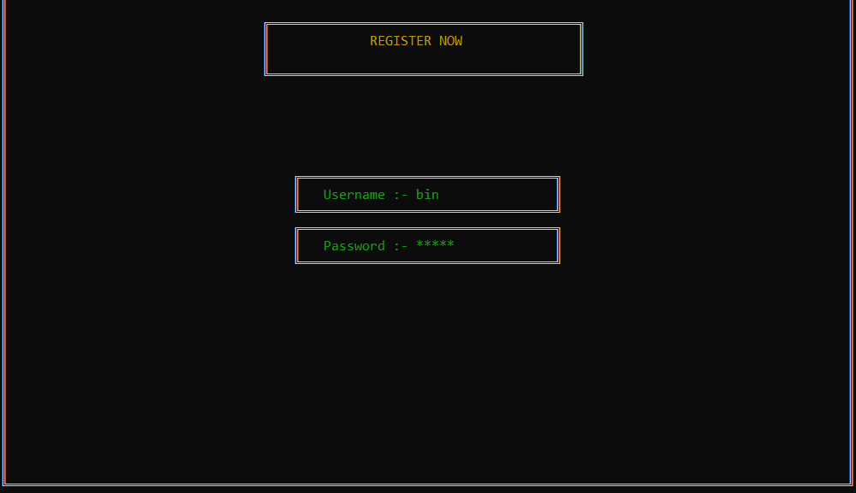
SCREENSHOTS
REGISTRATION
21
Notes:
page 21-26:these pages are the screen shots of our game. i will slowly move to the next ones as you take a look…first we have the registration page…next we have

Slide 22
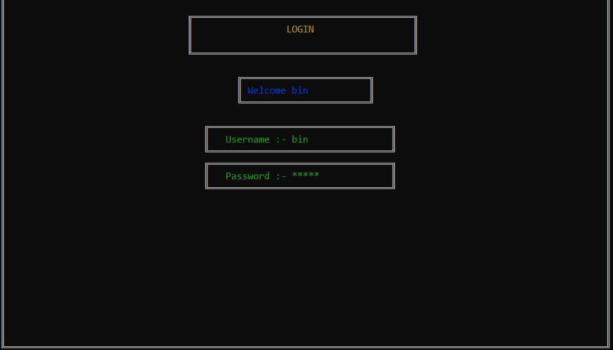
LOG IN
22
Notes:
The login page….up next we have

Slide 23
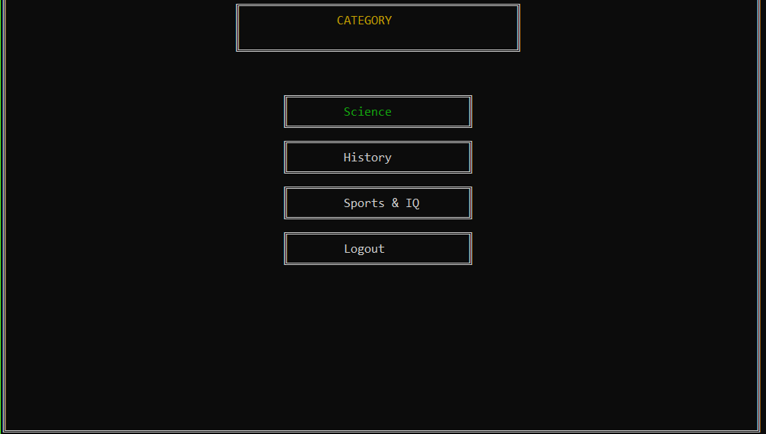
CATAGORY
23
Notes:
The category menu…Three categories to choose from………..then we have

Slide 24
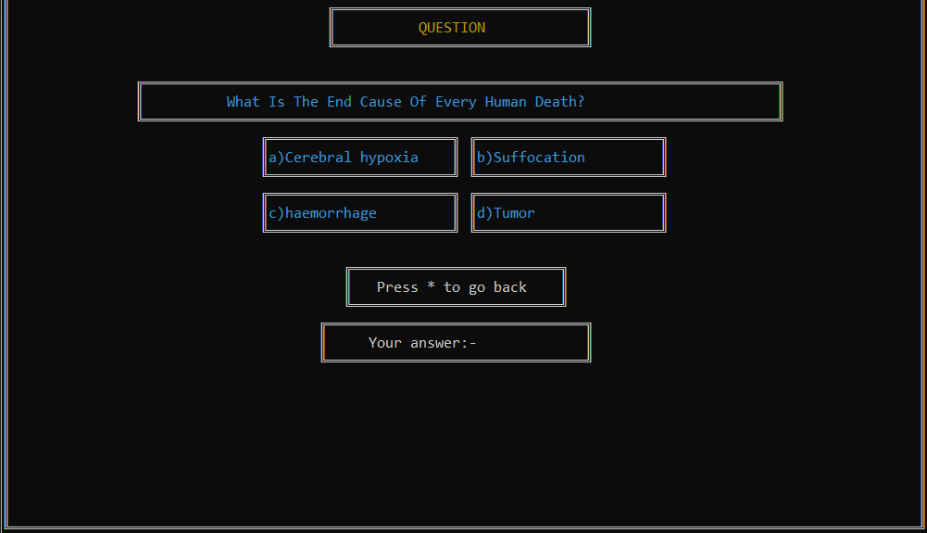
QUESTION GENERATE
24
Notes:
The question generation page………..next we have

Slide 25
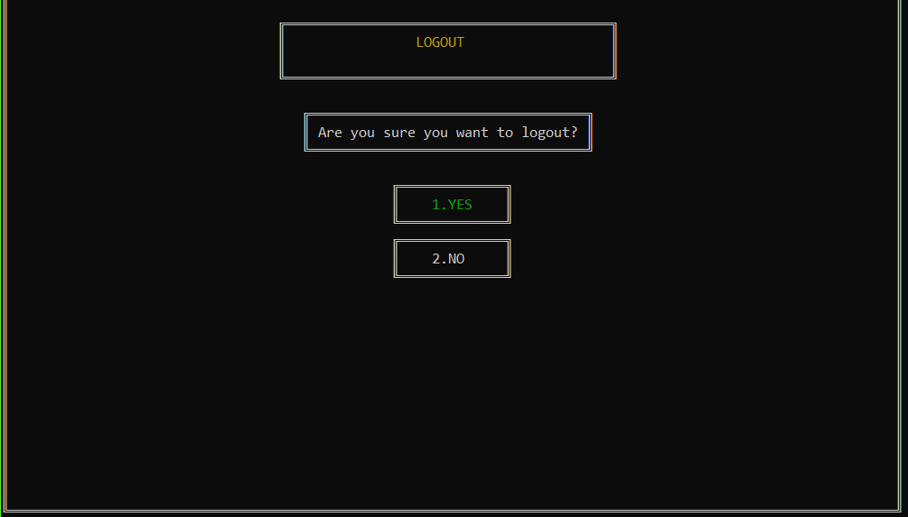
LOG OUT
25
Notes:
The logout options….and finally

Slide 26
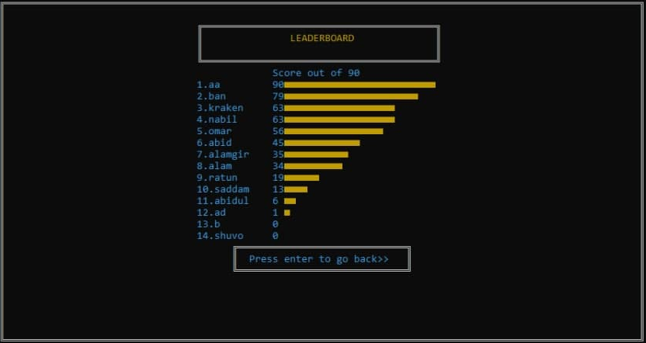
LEADERBOARD
26
Notes:
The leaderboard of which we are quite proud of. The scores are graphically represented and it gives a clear view of the current players scores.
To conclude the presentation, I want to call our remaining member Md. Omar Faruk. Omar please continue…

Slide 27
CONCLUSION AND FUTURE WORK
8
27

Slide 28
FUTURE WORK
We would love to extend this software to every reachable android device. As there are enormous amount of trivia games which are already famous, we have to implement something exceptional to make it top of the list. We intend to add:
Convert it to a better programing language such as object oriented programming.
More UIUX implementation.
Make it playable both online and offline.
Add people as friends.
Play live quiz at a time with same time limit and same question with your friend.
Add more & more categories.
28

Slide 29
CONCLUSION
Digitalization made everything easy & comfortable. There are so many of trivia games available but none of them are so mush user friendly and enjoyable as the question are not so much connected to our culture. Now, it’s a opportunity we use our vision and this software to give people our continent based question and more on.
29

Slide 30
REFERENCES
https://www.programiz.com
https://www.tutorialspoint.com
https://www.w3schools.com/
Simple snippets (YouTube)
30

Slide 31

FROM TEAM ATG
31

